Slide 1



COMMUNICATION AND SOCIAL IMPACT
Train the trainers
The RESIST project is co-financed by the European Union (European Regional Development Fund) under the Interreg Baltic Sea Region Programme.

Slide 2
01.
THE POWER OF COMMUNICATION
02.
INTERNAL AND EXTERNAL COMMUNICATION
03.
ROADMAP TO EFFECTIVE COMMUNICATION
04.
COMMUNICATE YOUR IMPACT
TABLE OF
CONTENT

Slide 3
01.
THE POWER OF COMMUNICATION

Slide 4

Communication is power and like all power, how you use it matters.
Communication can shine a spotlight on problems, making them easier to see and offering a stage to popularize solutions. It can call people to the streets, and it can bring people together. Silence is communication and actions are messaging without words.
Every organization communicates every day. But not every organization uses the full power of its communications to advance its ambitions. Instead, its communications become a noisemaker, a shame and blame purveyor, or a demotivator making everything seem impossible.

Slide 5






Are your communications fully alligned to what you want to accomplish as an organization?
Do you communications advance your values?
Alligned values and actions
Engagement
Do you actions tell the same story than what you are communicating?
Transparency
Storrytelling for impact

Slide 6


Communication is the lifeblood of any successful enterprise. It’s the glue that holds teams together, fosters understanding, and keeps external stakeholders engaged.
It’s not just about talking; it’s about connecting, aligning, and ultimately achieving your goals.

Slide 7
02.
INTERNAL AND EXTERNAL COMMUNICATION

Slide 8

External communication
External communication refers to the interaction of an organization with its external stakeholders, such as customers, investors, suppliers, media, regulators, and the general public. It can be proactive or reactive, strategic or operational, and involve different levels of disclosure and control.
Internal communication
Internal communication refers to the exchange of information and ideas within an organization. It can be formal or informal, vertical or horizontal, and involve various media and tools.

Slide 9

Internal and external communications should work together to create a smooth channel of information flow.
It’s important for the company to have a consistent image and message.
Effective internal and external communication is vital for the smooth operation of an organization, as miscommunication can lead to mission failure and financial losses.
Your employees will have a better understanding of what your organization stands for, and if they like it, they’ll share it with their world.

Slide 10


Monitor and measure
To ensure that your internal and external communication are aligned and effective, you need to monitor and measure their impact and outcomes.
Use various methods and tools to collect and analyze data: feedback forms, analytics, surveys etc.
Compare and contrast your internal and external communication results, and identify any gaps or discrepancies that need to be addressed.
Incorporate feedback and suggestions from internal and external stakeholders, such as employees, customers, partners, media, etc. Make the necessary changes and adjustments to your communication goals, strategies, tactics, channels, tools, content, tone, style, etc. to enhance your communication alignment and performance.

Slide 11
03.
THE ROADMAP TO EFFECTIVE COMMUNIATION

Slide 12



How to communicate?
Create a marketing strategy
Share mission-driven and value-driven stories
Make sure your message is consistent across all channels
Collaboration between the team is
“the key”
STRATEGY
STORYTELLING
CONSISTENCY
COLLABORATION

Slide 13

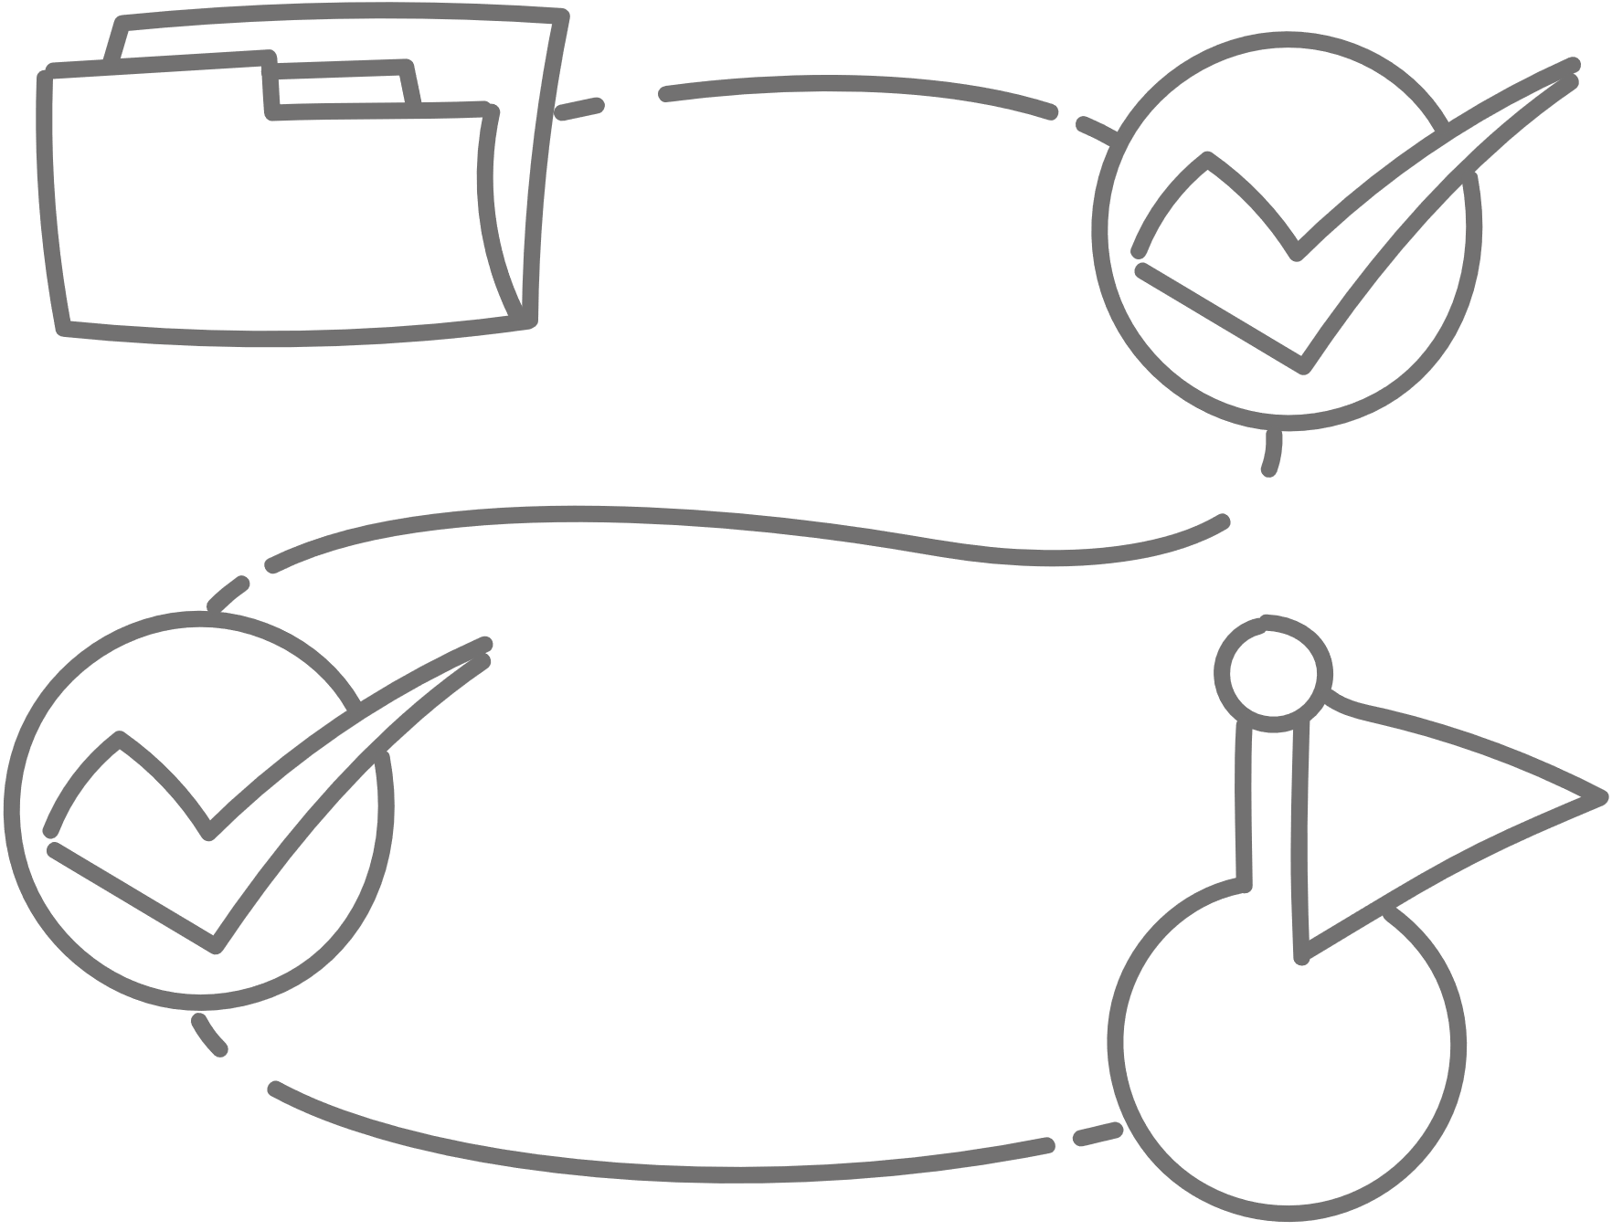
Roadmap to effective communication
Your mission
Your target audience
Collaboration
Your story to share

Slide 14


Your mission
  Identify the social issue you are addressing
  Set clear, measurable goals for your organization
  Define the unique values that differentiate your social enterprise

Slide 15
Know your target audience
  Segment your audience based on demographics, interests, and psychographics
  Conduct thorough research to gain insights into their needs, aspirations, and communication preferences.
  Adapt your communication style to resonate with your target audience

Slide 16

Your story
  Focus on personal experience
  Where did the idea come from?
  Highlight points of difference
  Showcase the positive change
  Highlight the journey of your organization and its milestones
  Why it matters to support your idea and social cause?

Slide 17




Collaboration
  Engage with stakeholders, investors
  Network
  Invite your audience to collaborate
  Highlight the “impact to date” part of the story to show that there is evidence of change

Slide 18
04.
COMMUNICATE YOUR IMPACT

Slide 19

How do you show the value and impact of your work to others, such as funders, policymakers, partners, or clients?
Communicating the social impact of your work is not only important for securing resources and support, but also for demonstrating your accountability, learning from your outcomes, and improving your practice.

Slide 20

Benefits of communicating your social impact
When your business communicates the tangible benefits of its social impact, it can generate positive public perception.
  More visibility
  Encanced brand reputation
  Competitive advantage
  Increased employee engagement
  Increased customer satisfaction

Slide 21
More effective impact communication
Tailor your communication
Know your audience
Test and improve
Consider who your audience is, what they want to know, how they prefer to receive information, and what you want them to do.
Use clear, simple, and respectful language, and avoid jargon, acronyms, or technical terms.
Testing and improving your impact communication means evaluating the effectiveness and quality of your communication and making changes based on feedback and results. Seek feedback from your audience, your stakeholders, your peers, or your mentors.
To make your impact communication more effective, you need to tailor it to your audience. Tailoring your impact communication means adapting your content, style, and tone to suit the needs, interests, and expectations of your audience (families, parents, professionals, GenZ)

Slide 22

Core values matter
Website and blogs
List your core values on your website
Values through action
Display your values through action
Social media channels
Use different channels to reach diverse audience
Reviews
Importance of customer reviews

Slide 23




Be clear and concise
Be transparent
Be interactive
Be inspiring

Slide 24
What you do, speaks so loudly that your words I can not hear
Ralph Waldo Emerson

Slide 25

THANK YOU

